Slide 1
PROJECT: “PERSONAL FINANCE MANAGEMENT SYSTEM”
SUBMITTED BY: AYESHA AKRAM 2024-SET- 07 ROMAAN HAFEEZ 2024-SET-38 ROMAN SHABIR 2024-SET-37 UME HABIBA 2024-SET-24
LAB INSTRUCTOR: ENGR. ZEESHAN RASHID

Slide 2
Title: Personal Finance Manager in C++
A simple program to track income, expenses, and savings goals.

Slide 3
Introduction:
What is the program?
A C++ program to manage personal finances.
Tracks income, expenses, and savings goals.
Provides a summary of financial activities.
Why is it useful?
Helps users monitor their spending and savings.
Encourages better financial planning.

Slide 4
Program Features
Key Features:
1. Add Income:
Record money earned.
2. Add Expense:
Record money spent.
3. Set Savings Goal:
Define a target savings amount.
4. Display Summary:
View total income, expenses, balance, and progress toward the savings goal.

Slide 5
Limitations:
Maximum of 100 entries (can be expanded).
Basic command-line interface.

Slide 6
Code Structure
Main Components:
Code Organization:
Modular structure with separate functions for each feature.
1. FinanceEntry Struct:
Stores date, category, amount, and type (income/expense).
2. Global Variables:
entries[MAX_ENTRIES]: Array to store financial entries.
entryCount: Tracks the number of entries.
savingsGoal: Stores the user's savings target.
3. Functions:
calculateBalance(): Computes the current balance.
addEntry(bool isIncome): Adds a new income or expense.
setSavingsGoal(): Sets the savings goal.
displaySummary(): Displays a summary of finances.

Slide 7
Key Functions
calculateBalance():
- Iterates through all entries.
- Adds income and subtracts expenses to compute the balance.
addEntry(bool isIncome):
- Prompts the user for date, category, and amount.
- Adds the entry to the `entries` array.
Set Savings Goal:
- User input for savings goal amount.
- Stores goal amount in a global variable
displaySummary():
- Displays all entries with their type (income/expense).
- Shows total income, total expenses, balance, and progress toward the savings goal.

Slide 8
Code Snippets Slide
Selected Code Snippets:
calculateBalance() function
addEntry() function
displaySummary() function
Code: The actual code snippets for each function.

Slide 9
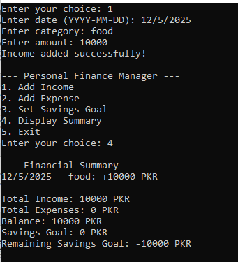
Demonstration
Step-by-Step Example:
1. Run the program and select "Add Income".
2. Enter date, category, and amount.
3. Select "Display Summary" to view the updated financial summary.
Example Output:

Slide 10
Improvements and Future Work
Possible Enhancements:
- Add data persistence (save entries to a file).
- Support for editing or deleting entries.
- Graphical user interface (GUI).
- Categorize expenses (e.g., food, transportation).
- Generate reports or charts.
Scalability:
- Use dynamic data structures (e.g., std::vector) to handle more entries.

Slide 11
Conclusion
Summary:
The program is a simple yet effective tool for managing personal finances.
It demonstrates core C++ concepts like structs, arrays, and functions.
Call to Action:
Try the program and explore ways to improve it!

